Slide 1
PHARMACY management system
A
PROJECT PRESENTATION
ON
Submitted by:
Bikash Singh, 15371
Damber Upadhyay, 15387
Pravin Gautam, 15365
Submitted to:
Research and Development Department
Nepal college of information technology(NCIT), Balkumari, Lalaitpur)

Slide 2
PHARMACY MANAGEMENT SYSTEM
Pharmacy management system is a windows application which aims in the management of the stock of the pharmaceutical store. This program can be used in any pharmaceutical store having a database to maintain.

Slide 3
Problems statement
The need of Pharmacy Management System is due to these problems
Searching of old customer data/list can create more problems.
Multiple numbers of medicine creates confusion to the user.
Tracking of pharmacy database manually is difficult.
Lack of good pharmacy management application.
Available application being either too complicated or lacking key features.

Slide 4
To solve the problems, the “Pharmacy management system ” is made.

Slide 5
Features of Pharmacy Management System
Features and functions are :
It has feature of Stock management
Sold medicine record keeping log menu
Purchased medicine record keeping log menu
Medicine stock management
Search to any data

Slide 6
Objective and aim
User can see information about pharmacy stock easily
User can check information about medicine
Data are protected with high security by implementing it at database level, so only authorized personnel have access
Application can also show out of stock items/medicines to owner
Data are accurately and efficiently saved
Information can be accurately and efficiently retrieved

Slide 7
Working of pharmacy management system

Slide 8
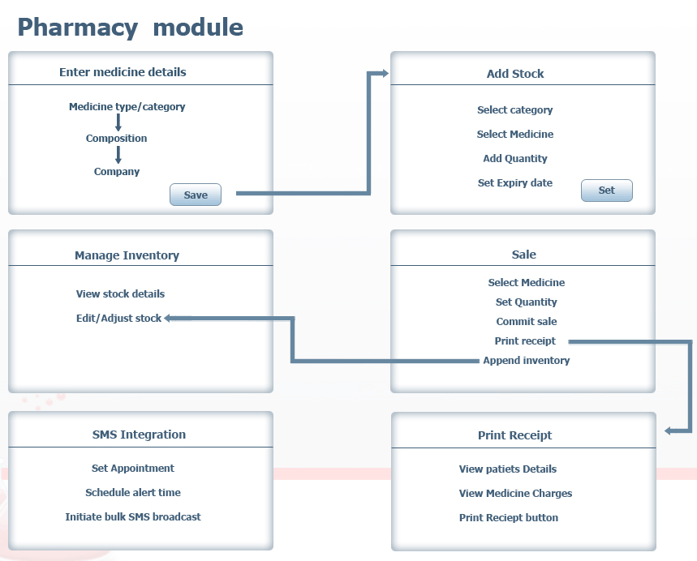
Print Sold Medicine
Print Purchased Stock
Print receipt
Fig. Working Flowchart

Slide 9
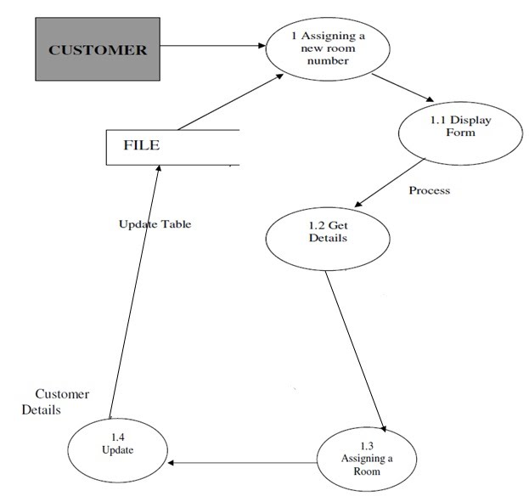
Pharmacy Record
Record List
Display Form
Get Details
Update
Edit List
Fig. Pharmacy Record Flowchart

Slide 10
Some Screen Shots of the system are:

Slide 11
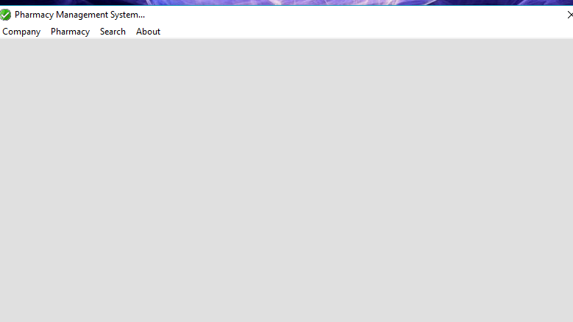

Slide 12
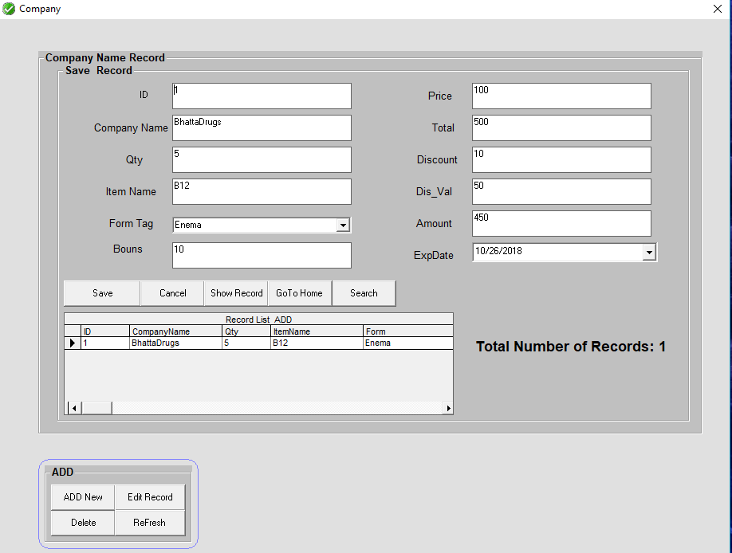

Slide 13
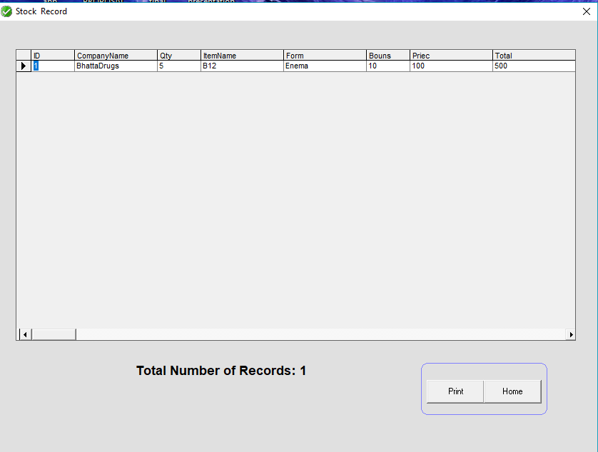

Slide 14
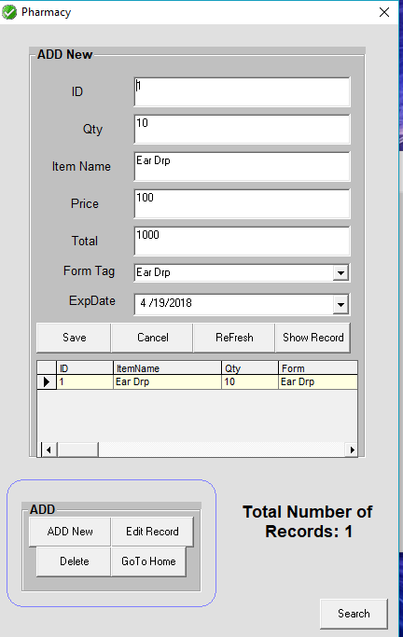

Slide 15
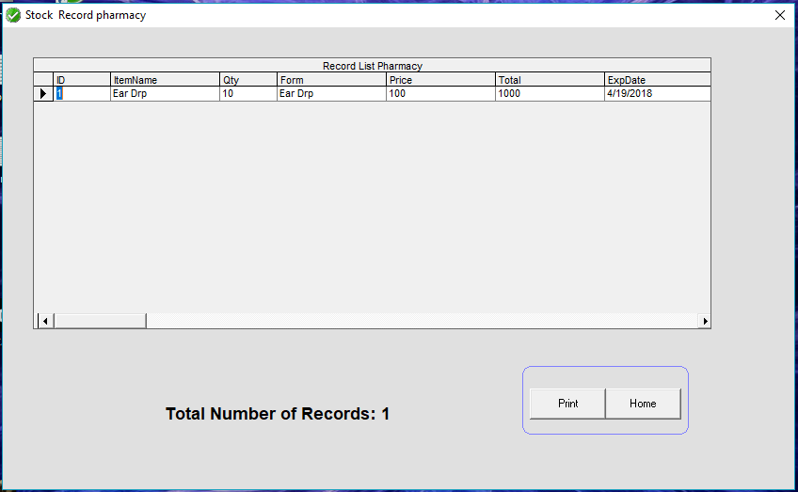

Slide 16
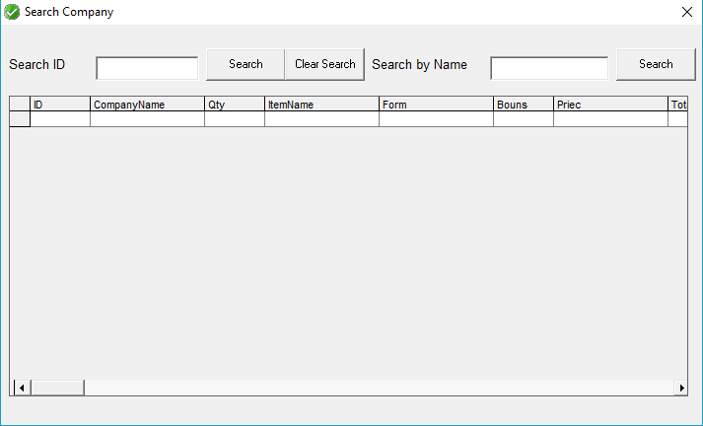

Slide 17
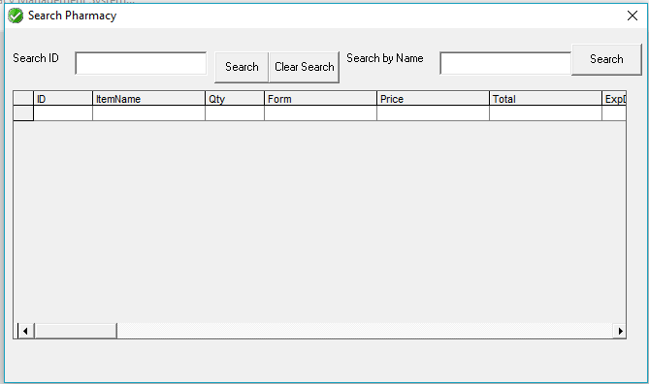

Slide 18
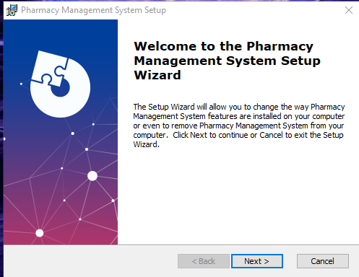
Installation of the Pharmacy Management System

Slide 19
Limitations :
Pharmacy management system is not fully completed management software.
It only runs in Windows platform. No other platforms are supported.

Slide 20
Conclusion
Pharmacy management system has simple and attractive user interface.
It has high security by implementing data at database level.
A semi-technical pharmacy owner can easily use Pharmacy Management System software.

Slide 21
Thank you
For
Watching

